Slide 1
Module 2 : Application Layer in the Internet
Internet Communication Engineering

Slide 2
CLIENT-SERVER PARADIGM
The purpose of a network, or an internetwork, is to provide services to users .
A user at a local site wants to receive a service from a computer at a remote site.
One way to achieve this purpose is to run two programs:
A local computer runs a program to request a service from a remote computer
the remote computer runs a program to give service to the requesting program.
This means that two computers, connected by an internet, must each run a program, one to provide a service and one to request a service.

Slide 3
Server & Client
Server :
Program running on the remote machine providing service to the clients .
A server program is an infinite program.
Client :
Program running on the local machine requesting service from a server.
It is finite and terminates when the service is complete.

Slide 4
Concurrency
Both clients and servers can run in concurrent mode :
Concurrency in Clients
Clients can be run on a machine either iteratively or concurrently
Running clients iteratively means running them one by one.
Concurrency in Servers
A concurrent server can process many requests at the same time and thus can share its time between many requests.
Server either use UDP(connectionless protocol) or TCP/SCTP (connection oriented protocol)
Server operation depends on 2 factors : Transport layer protocol & service method.

Slide 5
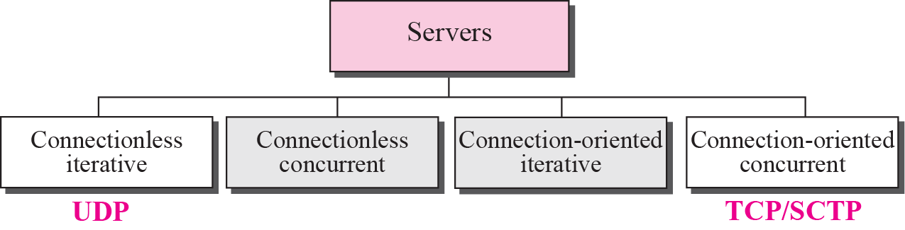
Servers

Slide 6
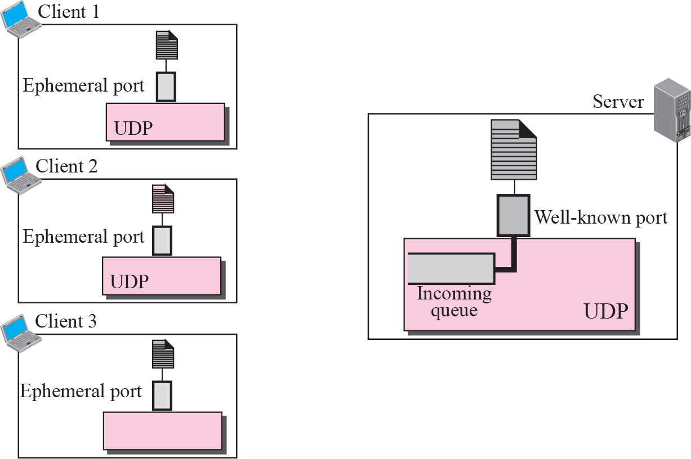
Connectionless iterative server

Slide 7
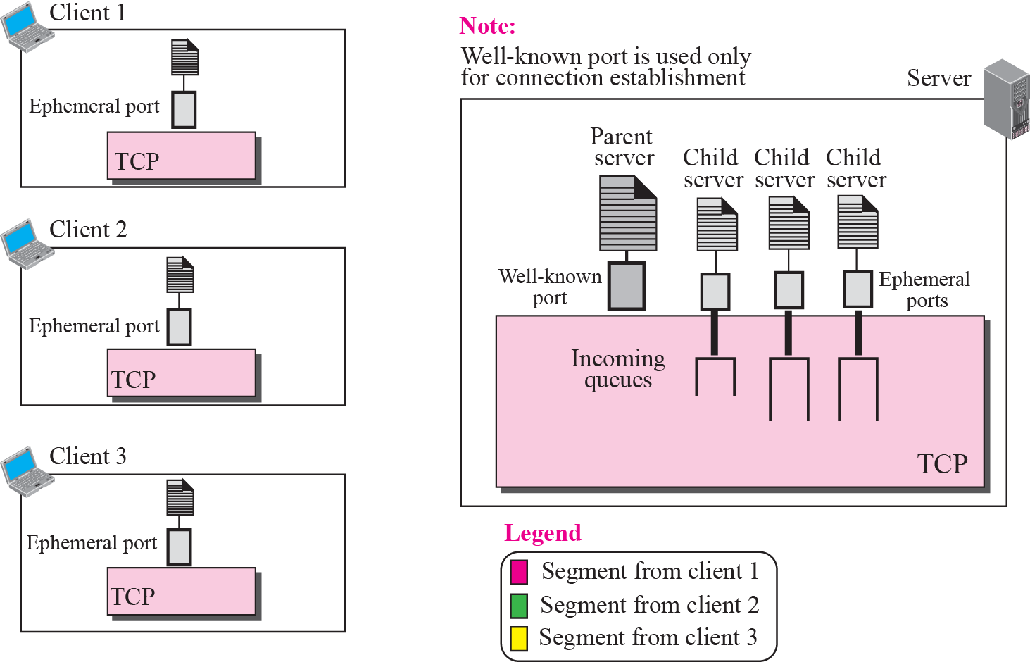
Connection-oriented concurrent server

Slide 8
Socket Interfaces
How can a client process communicate with a server process ??
-With the help of Interface.
Interface is a set of instructions designed for interaction between two entities.

Slide 9
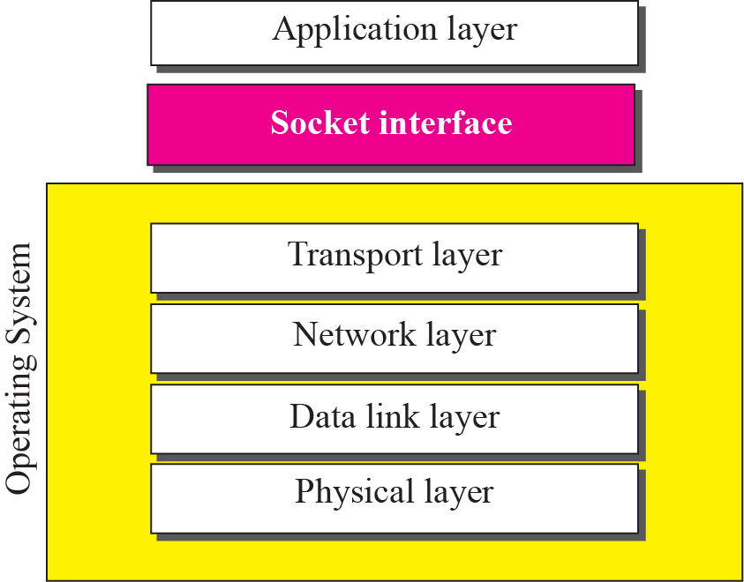
Relation between the operating system and the TCP/IP suite

Slide 10
Example
Most of the programming languages have a file interface, a set of instructions that allow the programmer to open a file, read from the file, write to the file, perform other operations on the file, and finally close the file. When a program needs to open the file, it uses the name of the file as it is known to the operation system. When the file is opened, the operating system returns a reference to the file (an integer or pointer) that can be used for other instructions, such as read and write.

Slide 11
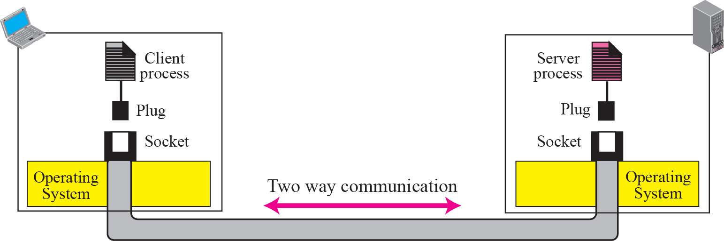
Concepts of sockets

Slide 12
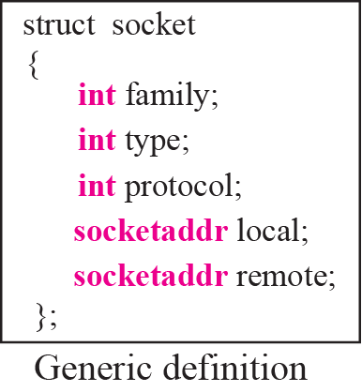
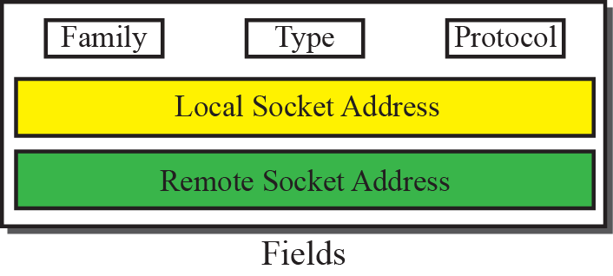
Socket data structure

Slide 13
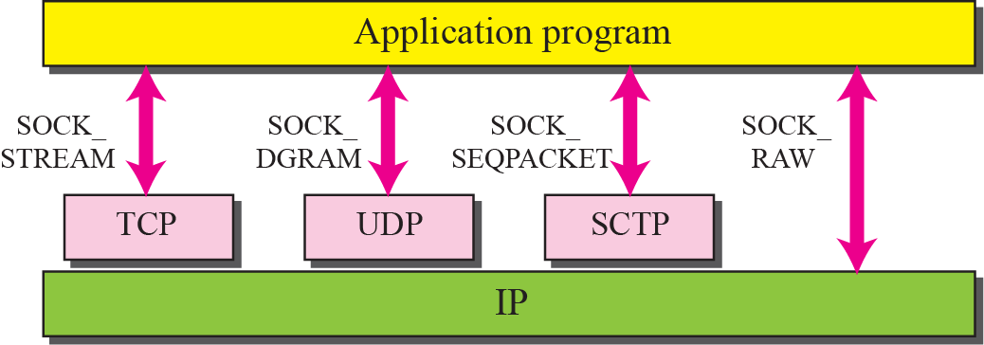
Socket Types

Slide 14
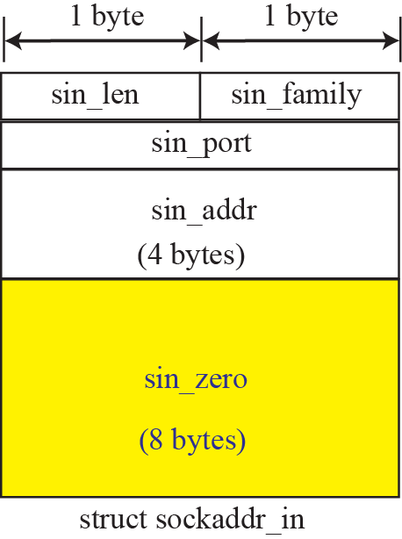
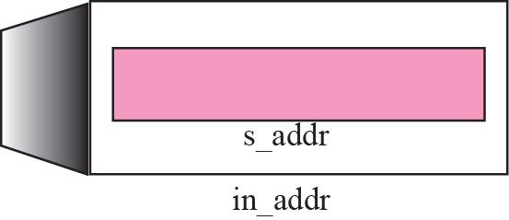
IPv4 Socket Address

Slide 15
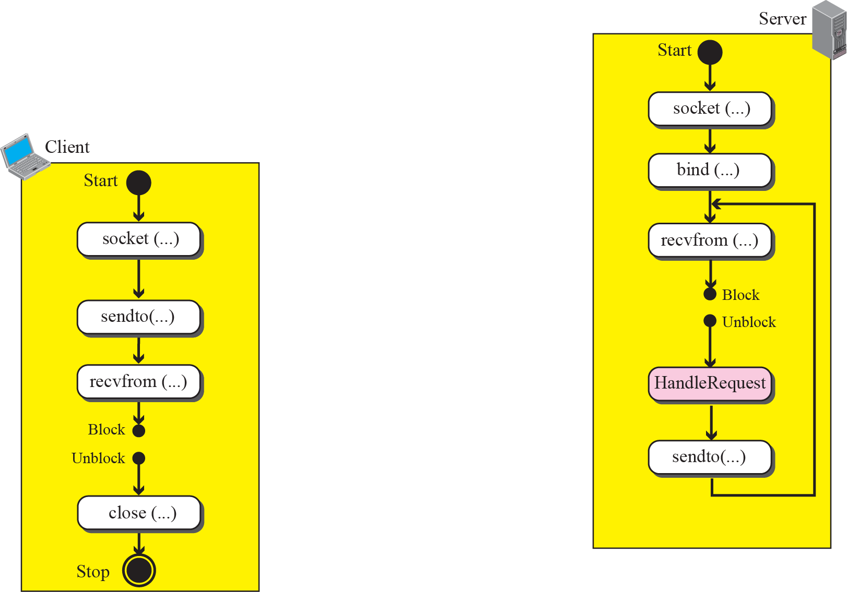
Connectionless iterative communication using UDP

Slide 16
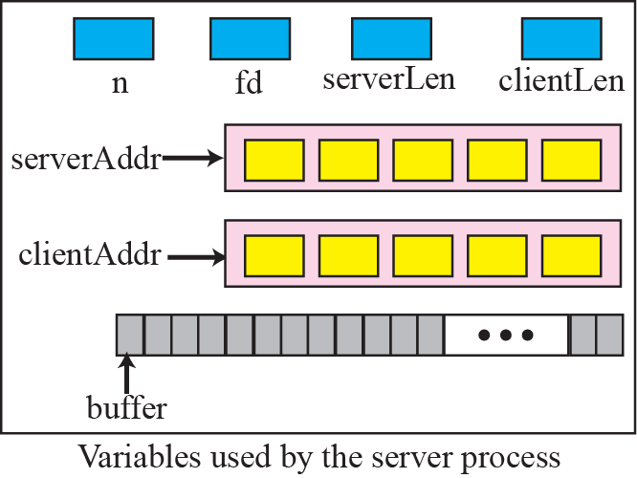
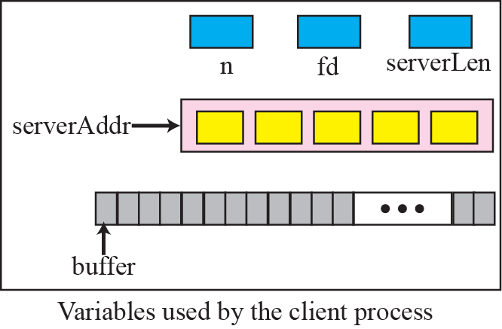
Variables used in echo server and echo client using UDP service

Slide 17
Communication using TCP
Server Process
Server process starts first
Socket is only used during connection establishment

Slide 18
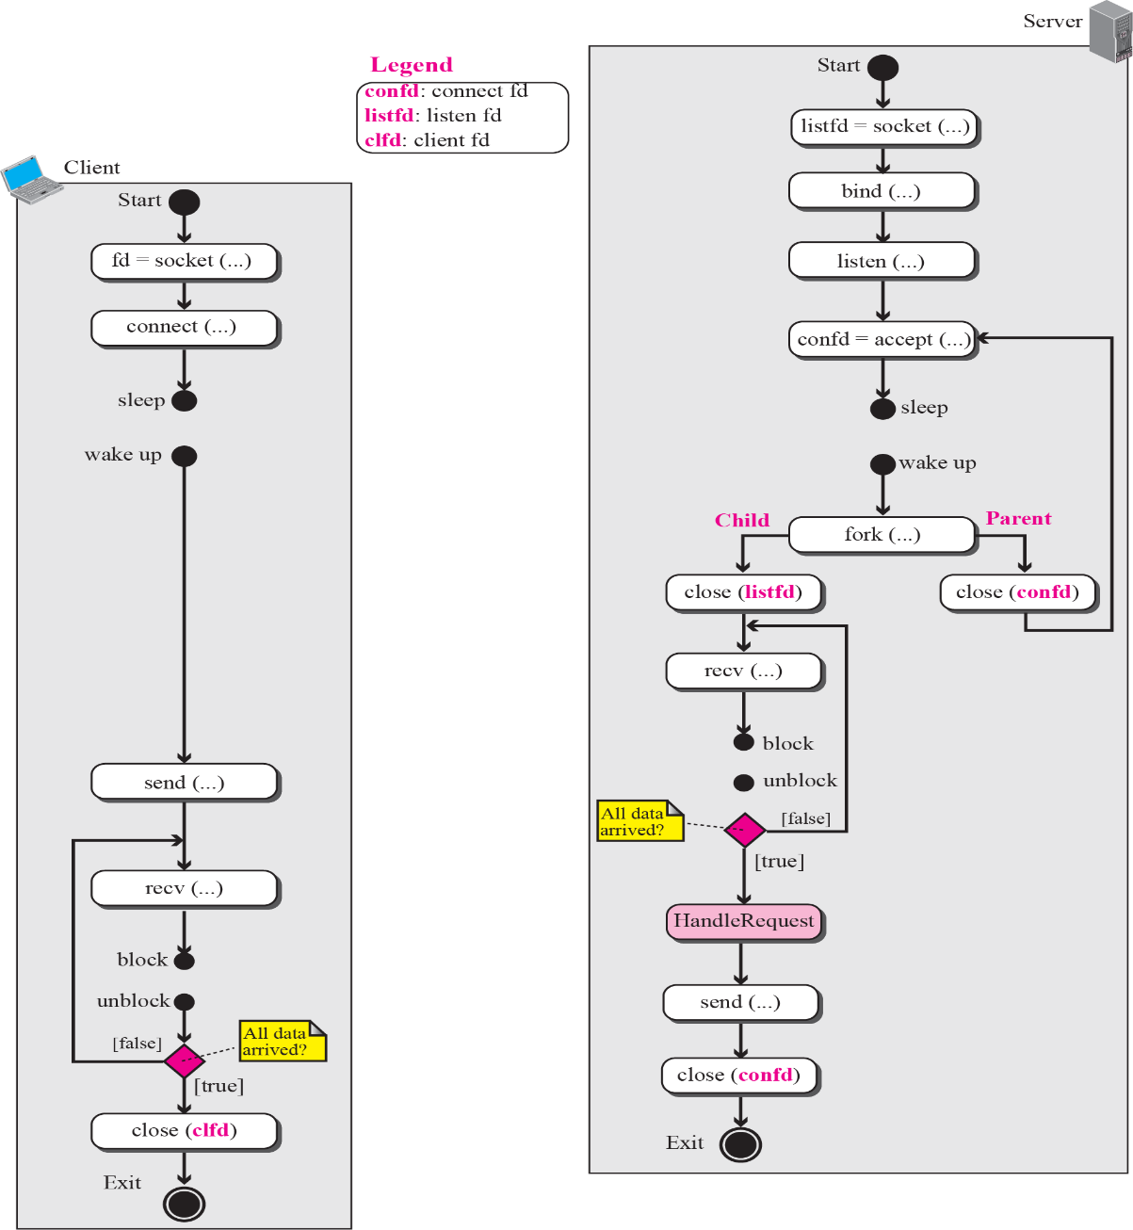
Flow diagram for connection-oriented, concurrent communication

Slide 19
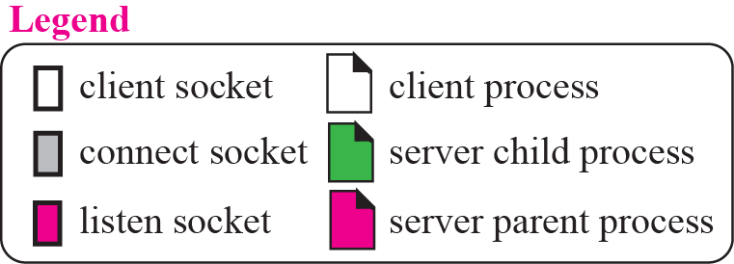
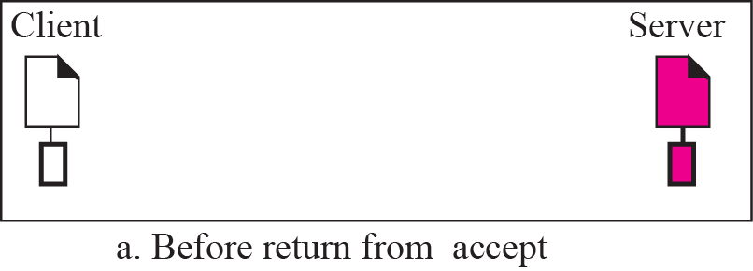
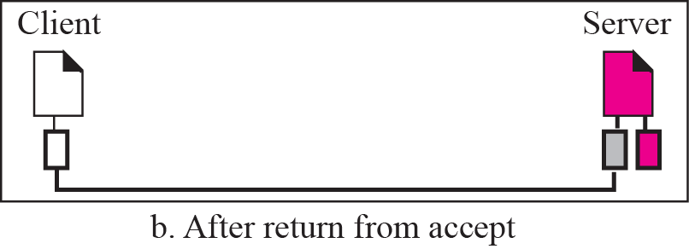
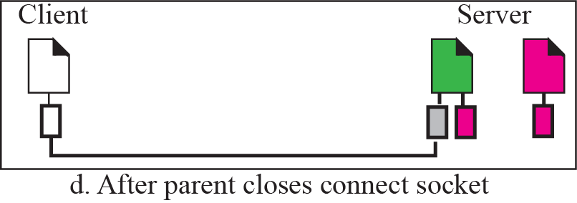
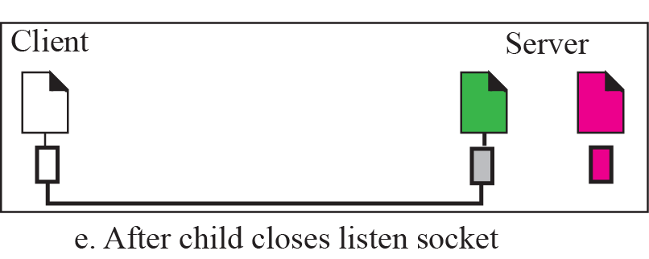
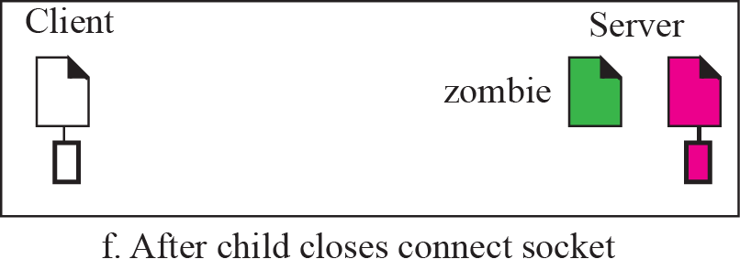
Status of parent and child processes with respect to the socket

Slide 20
Client Process
Client Process
Client calls socket function to create a socket
Then calls connect function to connect with server

Slide 21
Example
We want to write two programs to show how we can have an echo client and echo server using the services of TCP. Figure shows the variables we use in these two programs. Since data may arrive in different chunks, we need pointers to point to the buffer. The first buffer is fixed and always points to the beginning of the buffer; the second pointer is moving to let the arrived bytes be appended to the end of the previous section.

Slide 22
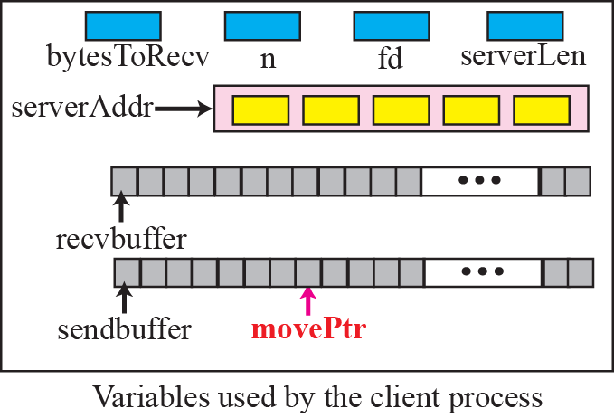
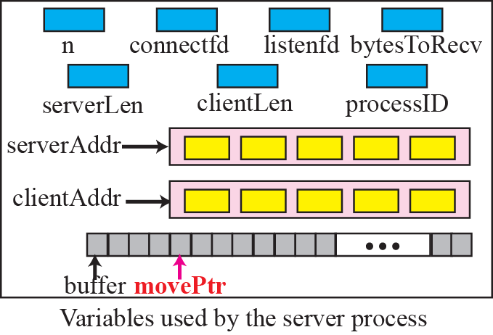
Variable used in echo client and echo sever using TCP

Slide 23
Peer to Peer Paradigm
In this paradigm, two peer computers can communicate with each other to exchange services.
This paradigm is interesting in some areas such as file transfer in which the client-server paradigm may put a lot of the load on the server machine.
However, P2P paradigm does not ignore the client-server paradigm; it is based on this paradigm.

Slide 24
Host Configuration: DHCP

Slide 25
Introduction
- Each computer that uses the TCP/IP protocol suite needs to know its IP address.
If the computer uses classless addressing or is a member of a subnet, it also needs to know its subnet mask.
Most computers need two other pieces of information: the address of a default router to be able to communicate with other networks and the address of a name server to be able to use names instead of addresses .
In other words, four pieces of information are normally needed.

Slide 26
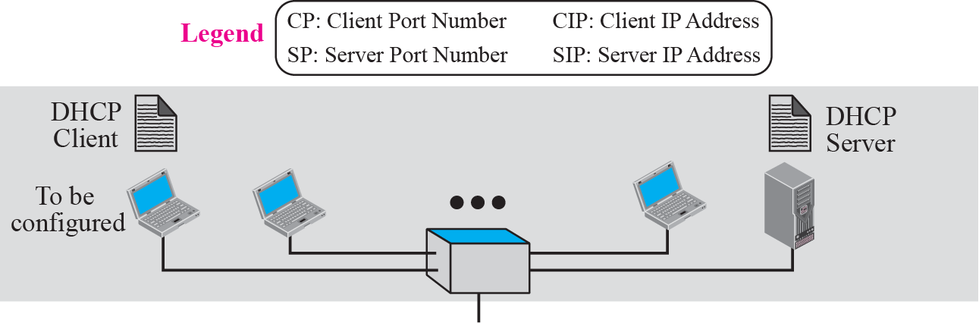
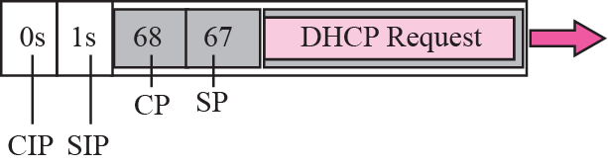
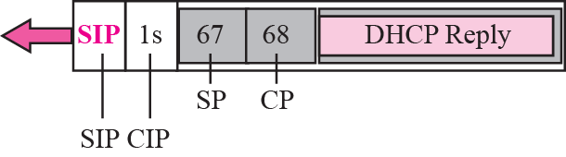
DHCP
DHCP is a client/server protocol designed to provide the four pieces of information for a diskless computer or a computer that is booted for the first time.
DHCP Operation: Client & Server on same network

Slide 27
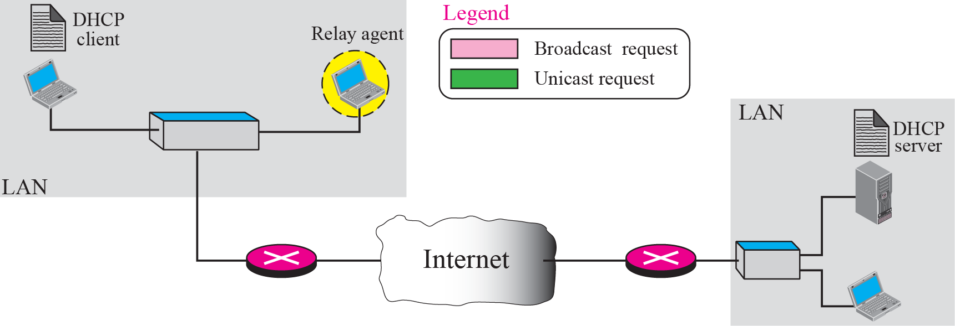
Client & Server on two different Networks

Slide 28
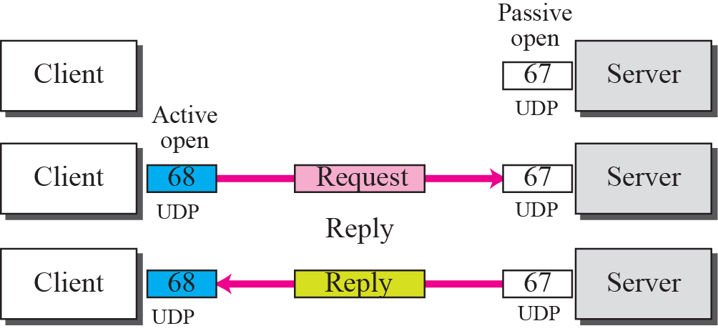
Use of UDP ports

Slide 29
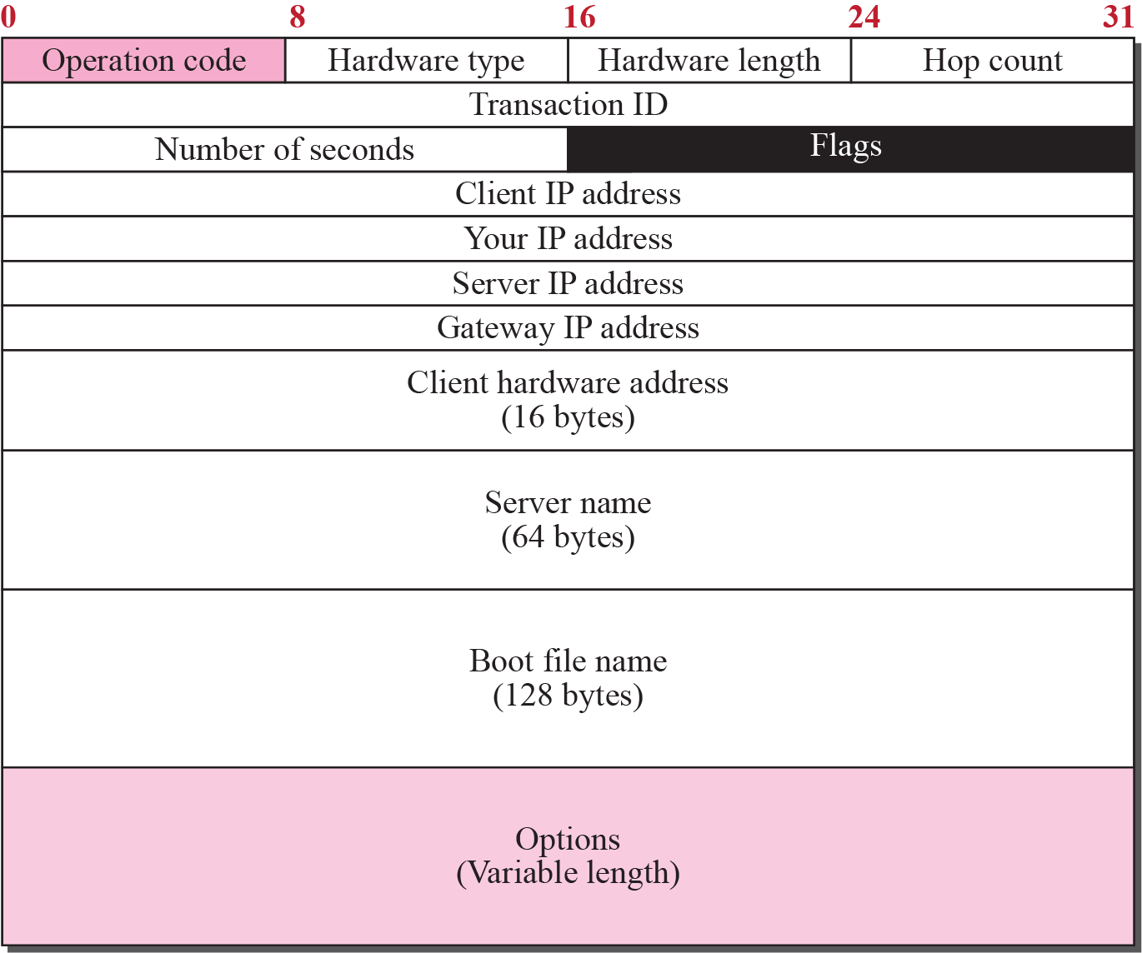
Error Control(DHCP packet format)

Slide 30
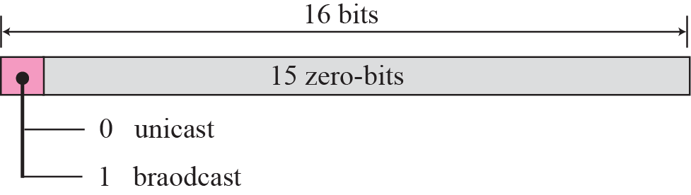
Flag Format

Slide 31
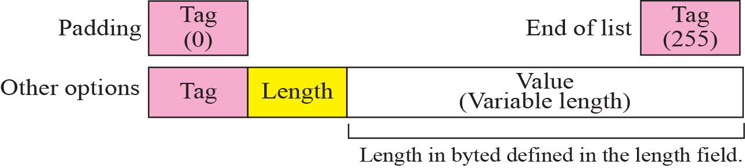
Option Format

Slide 32
Configuration
DHCP has been devised to provide static and dynamic address allocation
Static Address Allocation : DHCP server has a database that statically binds physical addresses to IP addresses.
Dynamic Address Allocation : When a DHCP client requests a temporary IP addresses, the DHCP server goes to pool of available IP addresses and assign IP address for a negotiable period of time.

Slide 33
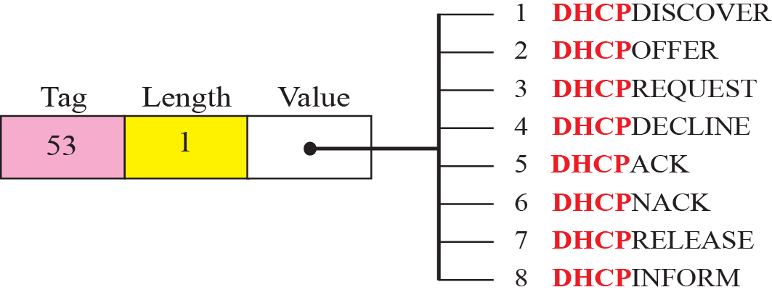
Transition States

Slide 34
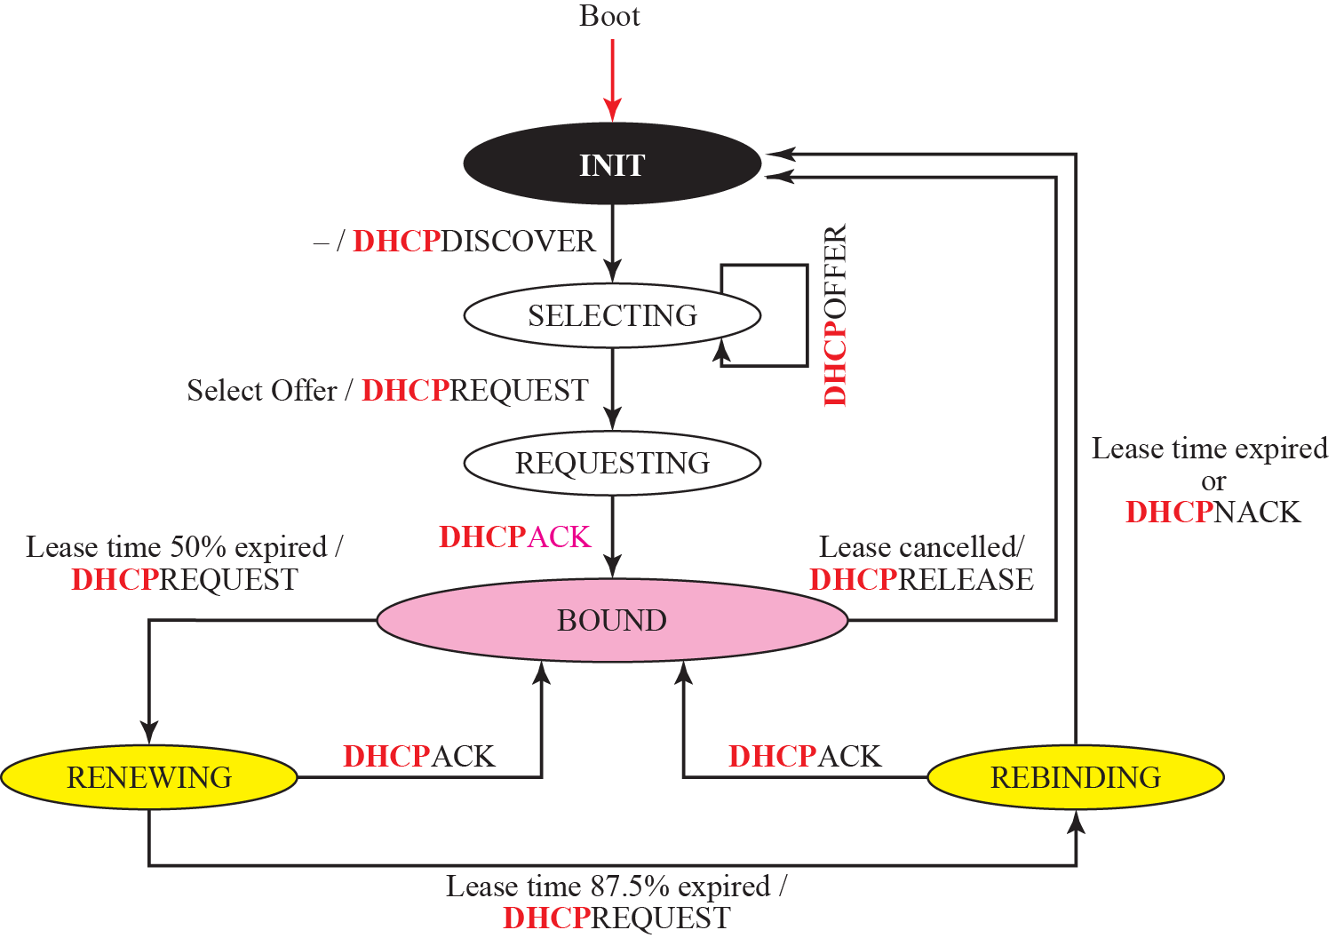

Slide 35
INIT State :
- When DHCP client first starts, it is in the INIT state.
Client broadcasts DHCPDISCOVER message using port 67.
SELECTING State :
After sending DHCPDISCOVER message, client goes to selecting state.
Servers with this service will respond with a DHCPOFFER message.
Server offers IP address also offers lease duration.

Slide 36
REQUESTING State :
Client remains in the requesting state until it receives a DHCPACK message from the server that creates binding between the client physical address and its IP address.
BOUND State :
Client can use IP address until lease expires.
When 50% of the lease period is reached, client sends another DHCPREQUEST to ask for renewal.
Client can cancel the lease if it is in the bound state.

Slide 37
RENEWING State :
Client remains in the renewing state until one of the 2 events happens :
1. It can receive a DHCPACK which renews the lease agreement. Client resets timer and goes back to the bound state.
If a DHCPACK is not received and 87.5% of the lease time expires , the client goes to the rebinding state.
REBINDING State :
Client remains in this state until one of the 3 events happen :
Client receives DHCPNACK or the 2. lease expires then it goes back to initializing state and tries to get another IP address.
3. Client receives DHCPACK , it goes to the bound state and resets the timer.

Slide 38
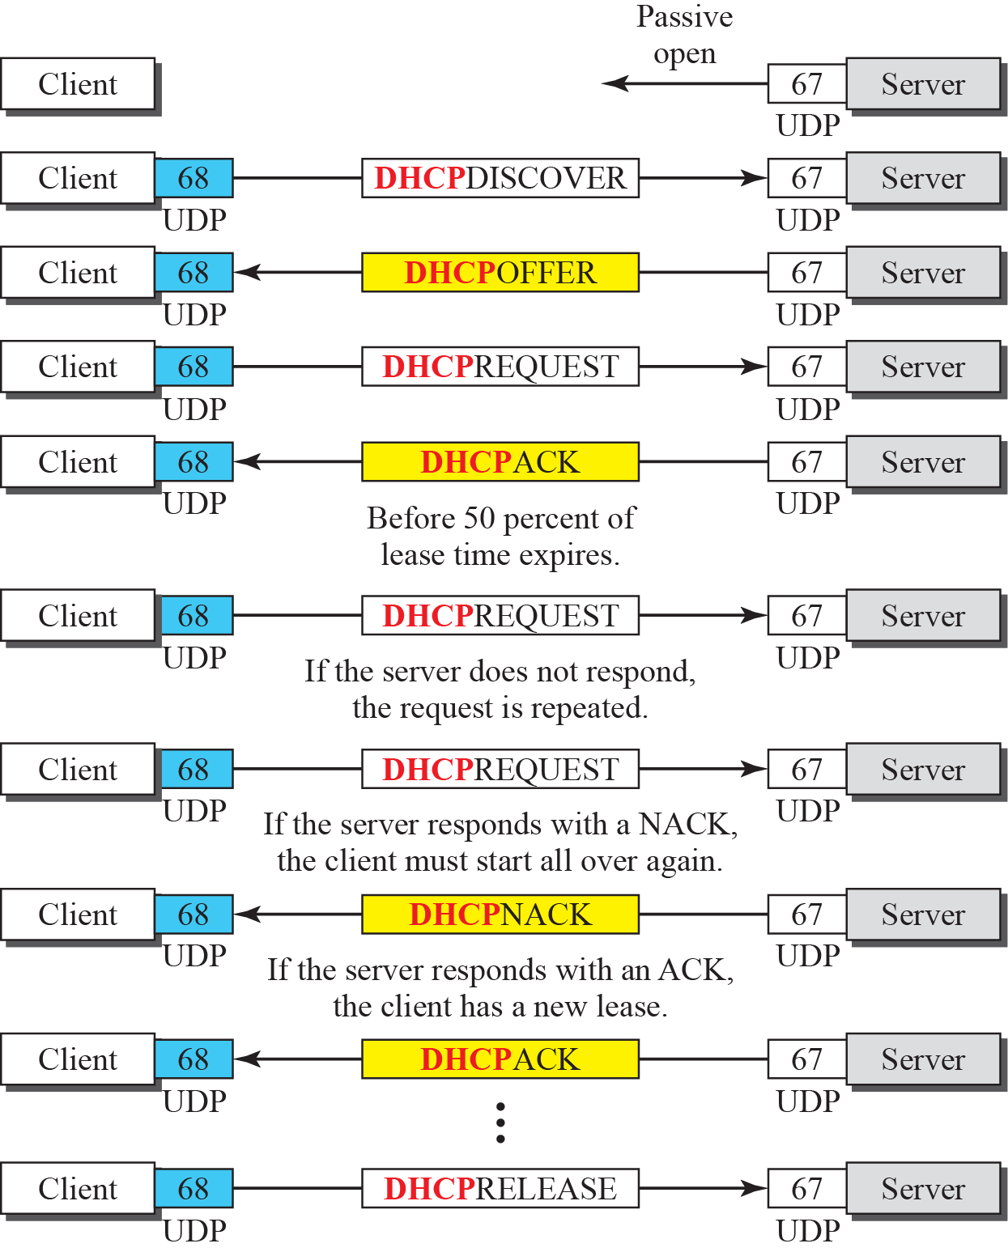
Exchange Messages

Slide 39
Domain Name System (DNS)

Slide 40
Need for DNS
To identify an entity, TCP/IP protocols use the IP address which uniquely identifies the connection of a host to the Internet.
However people prefer to use names instead of numeric addresses.
Therefore we need a system that can map a name to an address or an address to a name.

Slide 41
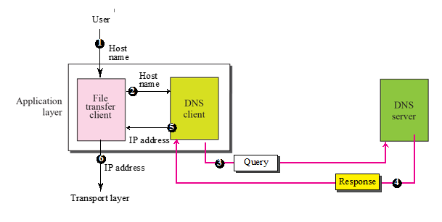
Purpose of DNS

Slide 42
Name Space
To be unambiguous, the names assigned to machines must be carefully selected from a name space with complete control over the binding between the names and IP addresses.
In other words, the names must be unique because the addresses are unique.
A name space that maps each address to a unique name can be organized in two ways: flat or hierarchical.

Slide 43
Types
Flat Name Space : In this a name is assigned to an address.
- Name in this space is a sequence of characters without structure.
- It cannot be used in a large systems.
Hierarchical Name Space : In this, each name is made of several parts.
First part defines the nature of organization
Second part can define name of the organization
Third part defines the departments of organization and so on.

Slide 44
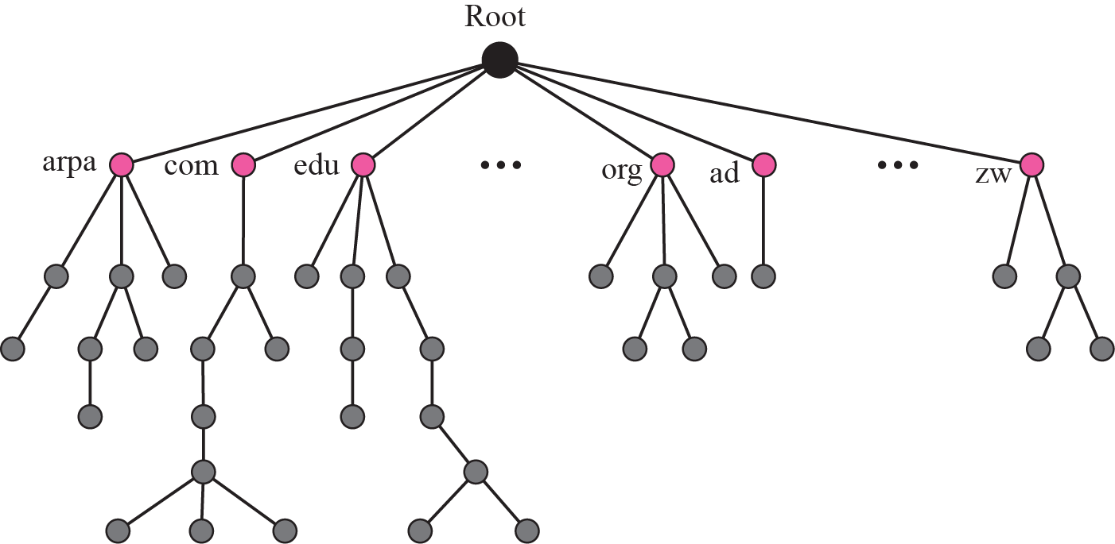
Domain Name Space

Slide 45
Contd…
Label : Each node in the tree has a label which is a string with a maximum of 63 characters
DNS requires that children of a node have different labels which guarantees the uniqueness of the domain names.
FQDN : If a label is terminated by a null string it is called FQDN.
It is a domain name that contains full name of a host.
PQDN : If the label is not terminated by a null string it is called PQDN.
- PQDN starts from a node but it does not reach the root.

Slide 46
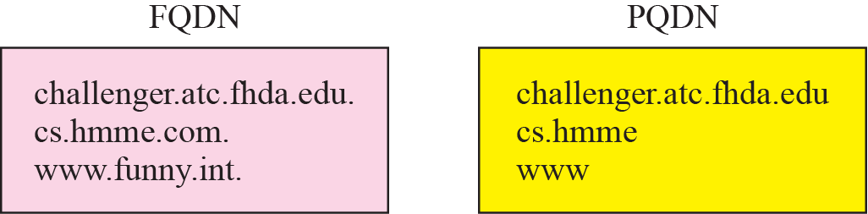
FQDN and PQDN

Slide 47
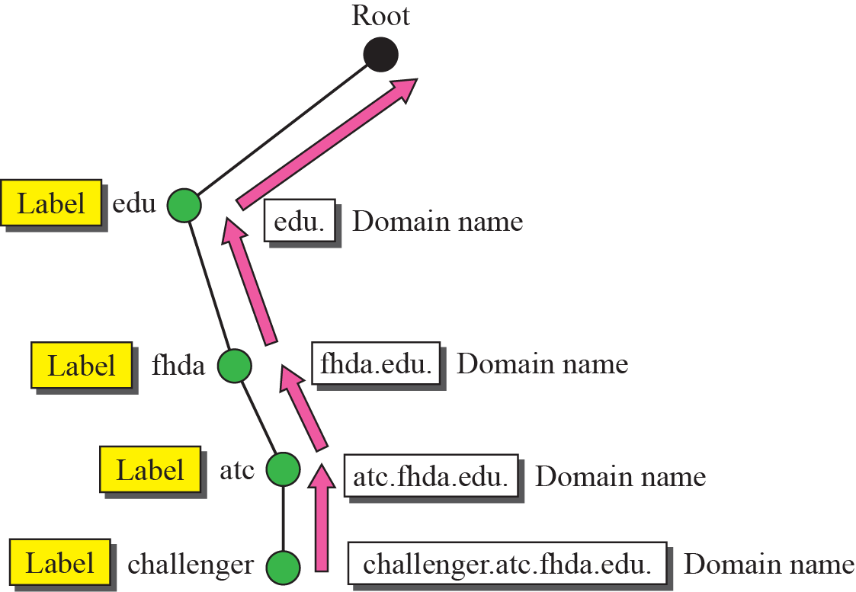
Domain Names & Labels

Slide 48
Domain
A domain is a subtree of the domain name space.
The name of the domain is the name of the node.
Domains may sometimes divided into subdomains.

Slide 49
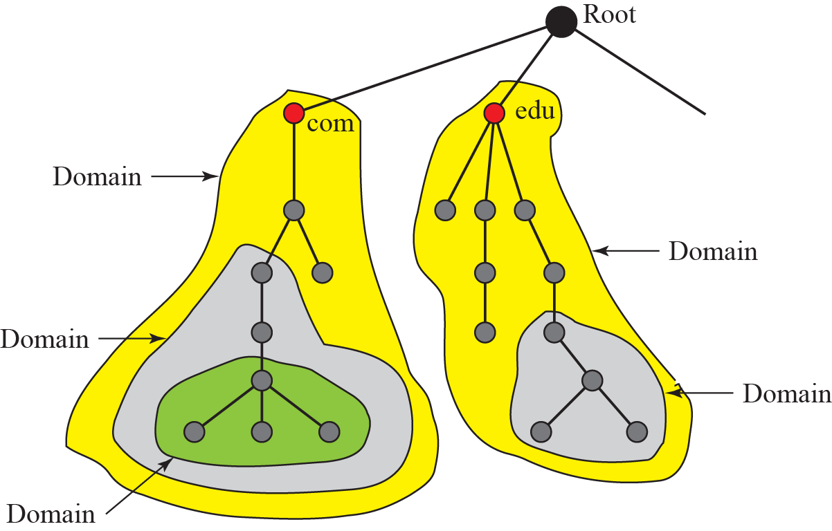
Domains

Slide 50
Contd…
Distribution of Name Space :
The information contained in the domain name must be stored.
However, it is very inefficient and also not reliable to have just one computer store for such a huge amount of information.
Hierarchy of Name Servers :
The solution for this problem is to distribute the information among many computers called DNS servers.
One way to do this is to divide the whole space into many domains based on the first level.

Slide 51
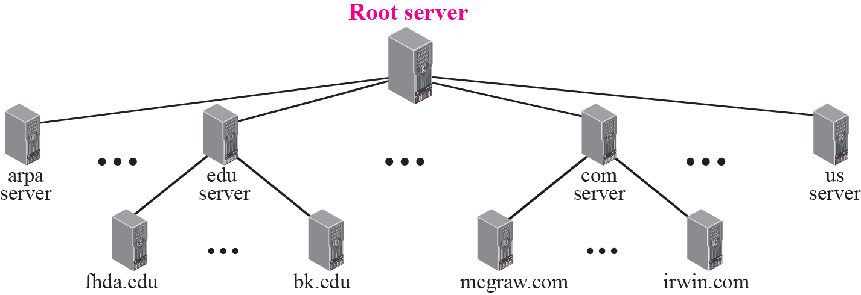
Hierarchy of name servers

Slide 52
Contd…
Zone:
Since the complete domain name hierarchy cannot be stored on a single server, it is divided among many servers.
What a server is responsible for or has authority over is called a zone.

Slide 53
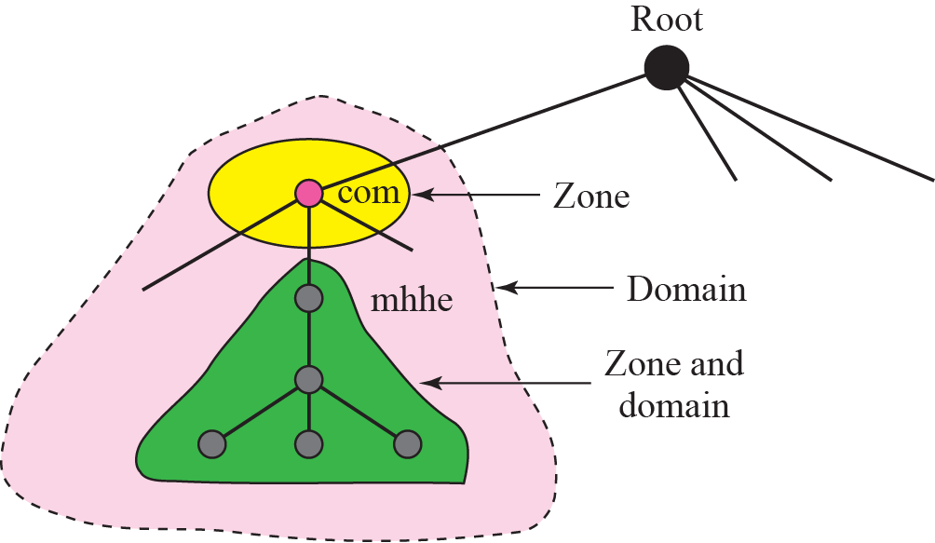
Zones and domains

Slide 54
Contd…
Root Server :
A root server is a server whose zone consists of the whole tree.
A root server usually does not store any information about domains but delegates its authority to other servers keeping references to those servers.
Primary and Secondary Servers :
A primary server is a server that stores a file about the zone for which it is an authority.
It is responsible for creating, maintaining and updating the zone file.
A secondary server is a server that transfers the complete information about a zone from another server and stores the file on its local disk.

Slide 55
DNS IN THE INTERNET
DNS is a protocol that can be used in different platforms.
In the Internet, the domain name space (tree) is divided into three different sections: generic domains, country domains, and the inverse domain.

Slide 56
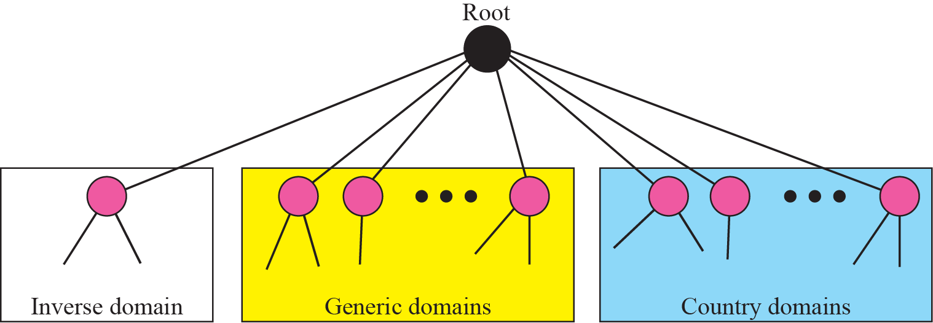
DNS used in the Internet

Slide 57
Generic Domains
The generic domains define registered hosts according to their generic behavior.
Each node in the tree defines a domain which is an index to the domain name space database.

Slide 58
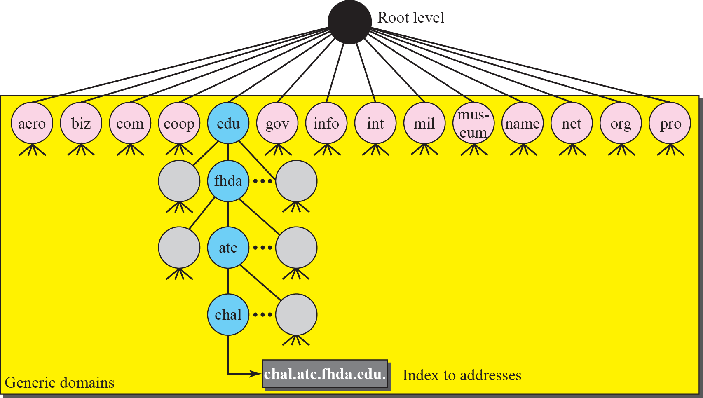
Generic domains

Slide 59
Country Domains
The country domains section uses two character country abbreviations.
Second label can be organizational or they can be more specific, national designations.

Slide 61
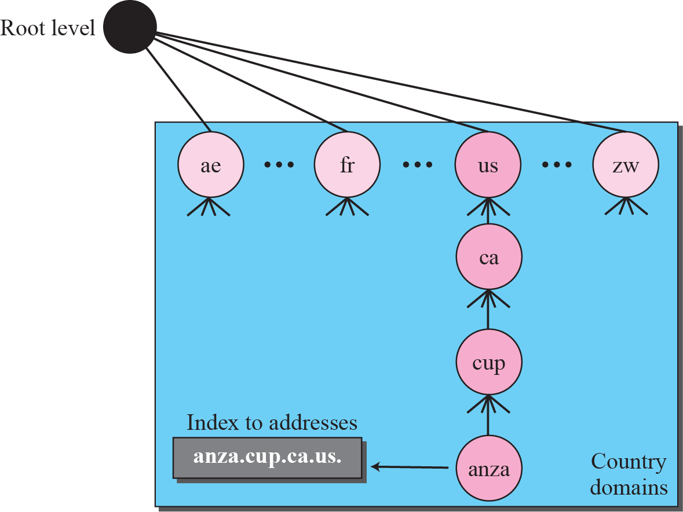
Country domains

Slide 62
Inverse Domain
The inverse domain is used to map an address to a name.
This may happen, for ex when a server has received a request from a client to do a task.

Slide 63
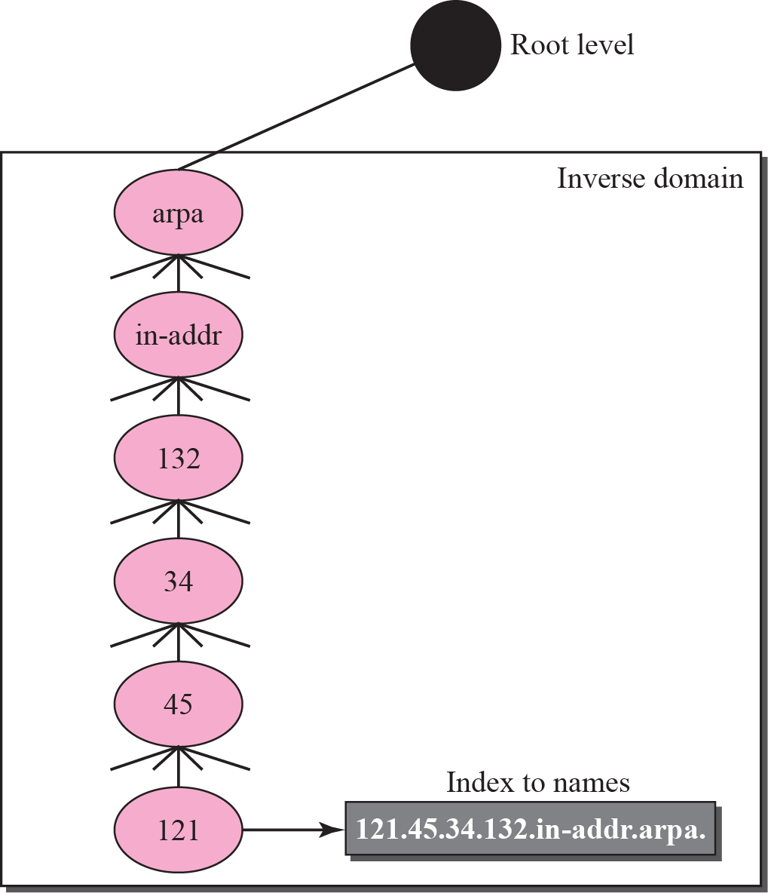
Inverse domain

Slide 64
Resolution
Mapping a name to an address or an address to a name is called name-address resolution.

Slide 65
Resolution
Resolver : A host that needs to map an address to a name or a name to an address calls a DNS client called a resolver.
The resolver accesses the closest DNS server with a mapping request.
If the server has the information, it satisfies the resolver otherwise it either refers the resolver to other servers or asks other servers to provide the information.

Slide 66
Resolution
Mapping Names to Addresses : Most of the time, the resolver a domain name to the server and asks for the corresponding address.
In such case, the server checks the generic domains or the country domains to find the mapping.

Slide 67
Resolution
Mapping Addresses to Names : A client can send an IP address to a server to be mapped to a domain name.
To answer queries of this kind, DNS uses the inverse domain.

Slide 68
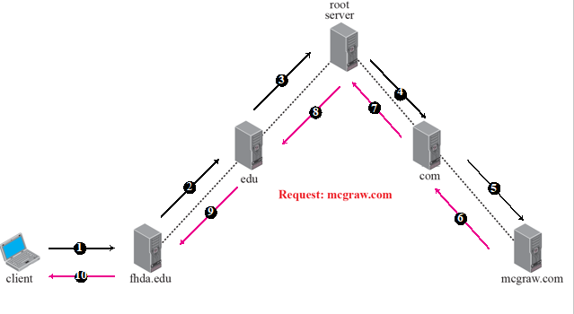
Recursive resolution

Slide 69
Recursive Resolution
The client (resolver) can ask for a recursive answer from a name server.
This means that resolver expects the server to supply the final answer.
If the server is the authority for the domain name, it checks its database and responds else it sends the request to another server & waits for the response.

Slide 70
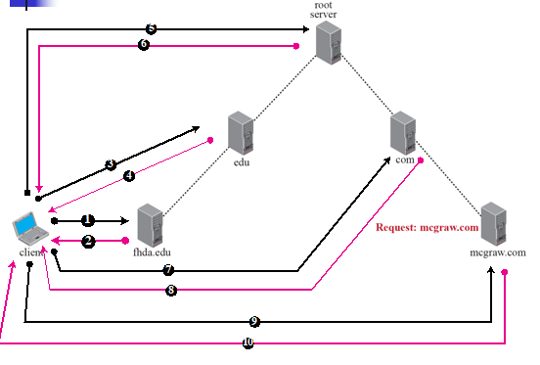

Iterative Resolution

Slide 71
Iterative Resolution
If the client does not ask for a recursive answer, the mapping can be done iteratively.
If the server is an authority for the name, it sends the answer.
If it is not, it returns the IP address of the server that it thinks can resolve the query.

Slide 72
Caching
Each time a server receives a query for a name that is not in its domain, it needs to search its database for a server IP address.
Reduction of this search time would increase efficiency.
DNS handles this with a mechanism called caching.

Slide 73
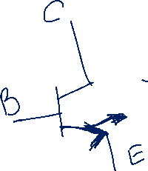

DNS Messages
DNS has two types of messages:
Query : consists of a header and question records.
Response : consists of a header, question records, answer records, authoritative records, and additional records .

Slide 74
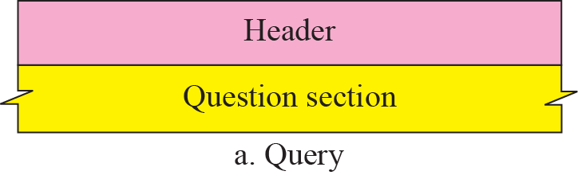
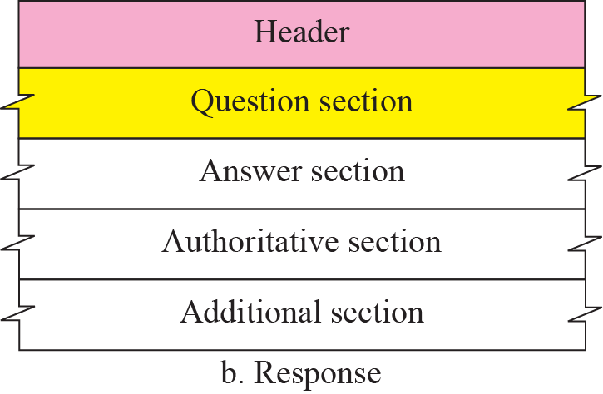
Query and response messages

Slide 75
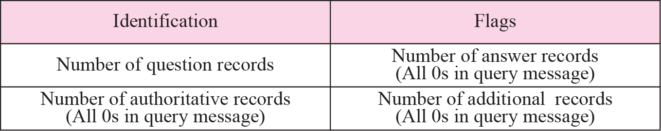
Header format

Slide 76

Header Fields
Identification : 16 bit field used by client to match the response with the query.
- Client uses different identification number each time it sends a query.
Flags : 16 bit field consisting of following subfields :

Slide 77
Flag Fields
QR (Query/Response) : Defines type of message.
0 – Query 1 – Response
Opcode : 4-bit subfield defines type of query or response
0– standard 1– Inverse 2- server status request
AA (Authoritative Answer) : Used only in a response message. When it is set then name server is authoritative server.
TC (Truncated) :It is used when DNS uses the services of UDP. When it is set means that the response was more than 512 bytes and truncated to 512.

Slide 78
Flag Fields
RD(Recursion Desired): Set in the query message and repeated in the response message. When set means client desires a recursive answer.
RA (Recursion Available) : Set only in the response message. When set in the response means recursive response is available.
Reserved : 3-bit subfield set to 000.
rCode : 4-bit field that shows the status of the error in the response. Only authoritative server can make such judgement.

Slide 80
Flags Field
Number of question records : 16 bit field containing number of queries in the question section of the message.
Number of answer records : 16 bit field containing number of answer records in the answer section of the response message. Its value is zero in the query message.
Number of authoritative records : 16-bit field containing the number of authoritative records in the authoritative section of response message.
Number of additional records : 16 bit field containing number of additional records.

Slide 81
Types of Records
2 Types of records
Question Record : Used by client to get information from a server.
Resource Record : These are used in the answer, authoritative and additional information sections of the response message.

Slide 82

Question Record format
Query Name : Variable length field containing domain name. The count field to the number of characters in each section.

Slide 83
Query Name Format

Slide 85


Slide 86

Resource record format

Slide 87
Fields
Domain Name : It is duplication of the domain name in the question record. Since DNS requires use of compression everywhere a name is repeated, this field is pointer offset to the corresponding domain name field in the question record.
Domain Type : Same as the query type field in the question record.
Domain class : Same as query class field.
Time to live : 32 bit field that defines the number of seconds the answer is valid.
Resource data length : 16 bit field defining length of resource data.
Resource Data : Field containing the answer to the query or the domain name of the authoritative server or additional information .
Number , A Domain Name , An offset pointer, A character string

Slide 88
COMPRESSION
DNS requires that a domain name be replaced by an offset pointer if it is repeated.
For example, in a resource record the domain name is usually a repetition of the domain name in the question record.
For efficiency, DNS defines a 2-byte offset pointer that points to a previous occurrence of the domain or part of it.

Slide 89

Format of an offset pointer

Slide 90
Example
A resolver sends a query message to a local server to find the IP address for the host “chal.fhda.edu.” Fig shows the query message sent by the resolver. The first 2 bytes show the identifier (1333)₁₆. It is used as a sequence number and relates a response to a query. The next bytes contain the flags with the
value of 0x0100 in hexadecimal. In binary it is 0000000100000000, but it is more meaningful to divide it into the fields as shown below:

Slide 91

Query message

Slide 92
Example
QR Bit (0) : Defines msg as a query
Opcode (0000) : Defines a standard query
RD Bit : Set
Message contains only one question record
The domain name is 4chal4fhda3edu0
The next 2 bytes define the query type as an IP address
The last 2 bytes define the class as the Internet

Slide 93
Example
An FTP server has received a packet from an FTP client with IP address . The FTP server wants to verify that the FTP client is an authorized client. The FTP server can consult a file containing the list of authorized clients. However, the file consists only of domain names. The FTP server has only the IP address of the requesting client, which was the source IP address in the received IP datagram. The FTP server asks the resolver (DNS client) to send an inverse query to a DNS server to ask for the name of the FTP client.

Slide 94

Inverse Query Message

Slide 95
Contd…
The first 2 bytes show the identifier (0x1200). The flags value is 0x0900 in hexadecimal. In binary it is 0000100100000000, and we divide it into fields as shown below:
The OpCode is 0001, which defines an inverse query. The message contains only one question record. The domain name is 19171231537in-addr4arpa. The next 2 bytes define the query type as PTR, and the last 2 bytes define the class as the Internet. The flags value is 0x8D80 in hexadecimal. In binary it is 1000110110000000, and we divide it into fields as shown below:

Slide 96
ENCAPSULATION
DNS can use either UDP or TCP. In both cases the well-known port used by the server is port 53. UDP is used when the size of the response message is less than 512 bytes because most UDP packages have a 512-byte packet size limit. If the size of the response message is more than 512 bytes, a TCP connection is used. In that case, one of two scenarios can occur:

Slide 97
Contd…
If the resolver has prior knowledge that size of the response message is more than 512 bytes, it uses the TCP connection.
If the resolver does not know the size of the response message, it can use the UDP port.

Slide 98
REGISTRARS
How are new domains added to DNS? This is done through a registrar, a commercial entity accredited by ICANN(Internet Corporation for Assigned Names and Numbers) .
A registrar first verifies that the requested domain name is unique and then enters it into the DNS database. A fee is charged.
There are many registrars, their names and addresses can be found at http://www.intenic.net

Slide 99
DDNS (Dynamic DNS)
When the DNS was designed, no one predicted that there would be so many address changes.
In DNS, when there is a change, such as adding a new host, removing a host, or changing an IP address, the change must be made to the DNS master file.
The DNS master file must be updated dynamically.
The Dynamic Domain Name System (DDNS) therefore was devised to respond to this need.

Slide 100
SECURITY OF DNS
DNS is one of the most important systems in the Internet infrastructure.
Applications such as Web access or e-mail are heavily dependent on the proper operation of DNS. DNS can be attacked in several Ways :
The attacker may read response of DNS server to find the nature or names of sites the user mostly accesses.
The attacker may intercept the response of a DNS server and change it or create totally new bogus response to direct the user to the site.
The attacker may flood the DNS server to overwhelm it or crash it.
To protect DNS, IETF has devised a technology named DNS Security (DNSSEC) that provides the message origin authentication and message integrity using a security service called digital signature.

Slide 101
SECURITY OF DNS
To protect DNS, IETF has devised a technology named DNS Security (DNSSEC) that provides the message origin authentication and message integrity using a security service called digital signature.
DNSSEC does not provide confidentiality for DNS messages.

Slide 102
Remote Login: TELNET and
SSH

Slide 103
TELNET
TELNET is an abbreviation for TErminaL NETwork.
It is a general purpose client server application program.
It is the standard TCP/IP protocol for virtual terminal service as proposed by ISO.
TELNET enables the establishment of a connection to a remote system in such a way that the local terminal appears to be a terminal at the remote system.

Slide 104
TELNET
Concepts :
Time sharing environment : In this, all of the processing must be done by central computer.
Time sharing creates an environment in which each user has illusion of a dedicated computer.
The user can run a program, access the system resources, switch from one program to another and so on.
Login : User has some rights to accesses.

Slide 105
TELNET
Concepts :
Login : User has some rights to access resources.
To access the system, the user logs into the system with a user id or login name.
The system also includes password checking to prevent an authorized user from accessing the resources.

Slide 106

TELNET: Local Login
Local Login : When a user logs into a local time sharing system it is called local login.

Slide 107

Remote Login
Remote Login : When user wants to access an application program or utility located on a remote machine, he or she performs Remote Login.

Slide 108

Concept of NVT

Slide 109

Format of data and control characters

Slide 111
Embedding
TELNET uses only one TCP connection
Server uses well known port and client uses ephemeral port.
Same connection is used for sending both data and control characters.
TELNET accomplishes this by embedding the control characters in the data stream.
To distinguish data from control characters, each sequence of control characters is preceded by special control character called IAC (Interpret As Control)

Slide 112

Example of Embedding

Slide 113
Options

Slide 114
Options
Binary : Allows the receiver to interpret every 8-bit character received except IAC as binary data.
Echo : Allows the server to echo data received from the client.
Suppress go-ahead : Suppresses the go-ahead character.
Status : Allows the user or the process running on the client machine to get the status of the options being enabled at the server site.
Timing mark : Allows one party to issue a timing mark that indicates all previously received data has been processed.

Slide 115
Options
Terminal type : Allows the client to send its terminal type.
Terminal Speed: Allows the client to send its terminal speed.
Line mode : Allows the client to switch to the line mode.

Slide 116


Slide 117

Offer to enable an option

Slide 118

Request to enable an option

Slide 119
Offer to disable an option

Slide 120
Request to disable an option

Slide 121
Example
Figure shows an example of option negotiation. In this example, the client wants the server to echo each character sent to the server. The echo option is enabled by the server because it is the server that sends the characters back to the user terminal. Therefore, the client should request from the server the enabling of the option using DO. The request consists of three characters: IAC, DO, and ECHO. The server accepts the request and enables the option. It informs the client by sending the three-character approval: IAC, WILL, and ECHO.

Slide 122

Echo option

Slide 123
Symmetry
One interesting feature of TELNET is its symmetric option negotiation in which client and server are given equal opportunity
Meaning is it is assumed that both sides are using default TELNET implementation with no options enabled at the beginning of connection.

Slide 124
Suboption Negotiation
Some options require additional information (Ex:To define type or speed of terminal)
Negotiation includes string or number to define type or speed.

Slide 125
Controlling the Server
Some control characters can be used to control the remote server.
When application program is running on local machine, special characters are used to interrupt the program.
But when program is running on remote machine, these control characters are sent to remote machine
User still types the same sequences but they are changed to special characters and sent to the server.

Slide 126

Example of sub-option negotiation

Slide 127


Slide 128
Contd…
IP : When a program is being run locally, the user can interrupt the program if for ex the program has gone into an infinite loop.
AO : This is same as IP, but it allows the process to continue without creating output.
AYT : This control character is used to determine if the remote machine is still up and running, especially after a long silence from the server.
EC : To erase the character received in a remote machine, TELNET defines EC control character.
EL : This is used to erase the current line in the remote host.

Slide 129

Example of interrupting an application program

Slide 130
Out of Band Signaling
To make control characters effective in special situations, TELNET uses out of band signaling.
In out of band signaling, the control characters are preceded by IAC and are sent to the remote process.

Slide 131

Out-of-band signaling

Slide 132
Escape Character
A character typed by the user is normally sent to the server.
But sometimes the user wants characters interpreted by the client instead of the server
In such case, user can use an escape character (ctrl+]).

Slide 133


Two different interruptions

Slide 134
Modes of Operation
Most TELNET implementations operate in one of three modes :
1) Default Mode : This mode is used when no other modes are invoked through option negotiation.

Slide 135
Example
In this example, we use the default mode to show the concept and its deficiencies even though it is almost obsolete today. The client and the server negotiate the terminal type and terminal speed and then the server checks the login and password of the user.

Slide 136

Example

Slide 137
Modes of Operation
2) Character Mode : Each character typed by the client is sent to the server.
In this mode, the echoing of the character can be delayed if the transmission time is long.
It also creates overhead for the network because 3 TCP segments must be sent for each character of data.

Slide 138
Example
In this example, we show how the client switches to the character mode. This requires that the client request the server to enable the SUPPRESS GO AHEAD and ECHO options.

Slide 139

Example

Slide 140
Modes of Operation
3) Line Mode : In this mode, line editing (echoing, character erasing, line erasing and so on) is done by the client.
The client then sends the whole line to the server.

Slide 141
User Interface
The normal user does not use TELNET commands.
- Usually , the operating system defines an interface with user friendly commands.

Slide 143
SECURE SHELL (SSH)
Another popular remote login application program is Secure Shell (SSH).
SSH, like TELNET, uses TCP as the underlying transport protocol, but SSH is more secure and provides more services than TELNET.
There are 2 versions of SSH: SSH-1 & SSH-2.
But SSH-1 is now deprecated because of security flaws in it.

Slide 144

Components of SSH

Slide 145
Components
SSH Transport layer protocol (SSH-TRANS)
Since TCP is not secured transport layer protocol, SSH uses a protocol that creates a secured channel on the top of TCP.
This new layer is an independent protocol referred to as SSH-TRANS.
Services provided by this protocol :
Privacy or confidentiality of the message exchanged.
Data integrity.
Server authentication.
Compression of the messages.

Slide 146
Components
SSH Authentication protocol (SSH-AUTH)
After a secure channel is established between the client & server and the server is authenticated for the client, SSH can call another software that can authenticate the client for the server.

Slide 147
Components
SSH Connection protocol (SSH-CONN)
After a secured channel is established between the client & server and the server is authenticated for the client, SSH can call a piece of software that implements third protocol, SSH-CONN.
One of the services provided by SSH-CONN is to do multiplexing.
It takes the secure channel established by the two previous protocols and lets the client create multiple logical channels over it.

Slide 148
Components
SSH Applications
After the connection phase is completed, SSH allows several application programs to use the connection.
Each application can create a logical channel and then benefit from the secured connection.

Slide 149
Port Forwarding
SSH port forwarding mechanism creates a tunnel through which the messages belonging to other protocol can travel.
For this reason, this mechanism is sometimes referred as SSH tunneling.

Slide 150

Port Forwarding

